Slide 1
Economic analysis of liability,
or liability as an incentive policy tool :
Application to innovation fostering and risk regulation
Julien JACOB
BETA, Université de Lorraine
Workshop GREAT – Université Paris-Descartes
Paris, 23 avril 2013

Slide 2
Plan
Introduction
Application 1 : innovation fostering
Application 2 : risk regulation

Slide 3
Introduction
Liability in economics
Law and economics = “mainstream” economics
Neoclassic : scientist
mathematical formalization
optimization
perfect rationality
individualism
hypothetico-deductive method
Mathematical modeling, simplifications isolate effects

Slide 4
Introduction
Definitions
Liability = legal provision ($≠$ responsibility)
Civil liability = legal obligation to repair a damage caused because of our own activity.
Financial reparation = damages
Two economic issues
Ex post fairness, Justice
Ex ante incentives

Slide 5
Introduction
Classic representation
$$W −c\left(x\right)−p\left(x\right).L(x)$$
Net earning
from activity
Cost of prevention
Expected cost
in liability
Prevention ?
Costly effort
Reduces the probability of accident (and so, the expected damages…)

Slide 6
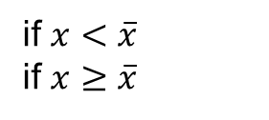
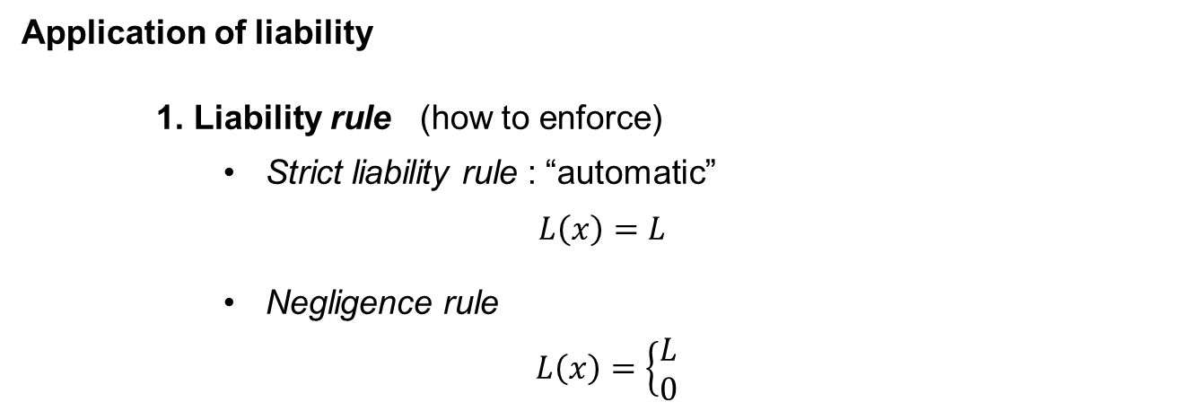
Introduction
Application of liability
1. Liability rule (how to enforce)
Strict liability rule : “automatic”
$L\left(x\right)=L$
Negligence rule
$L\left(x\right)=\left\{\begin{aligned}L \\ 0\end{aligned}\right.$
whatever x
if $x<\overline{x}$
if $x≥\overline{x}$
$\overline{x}$ = standard
of due care
2. Liability regime (extent of liability)
Unlimited liability
$$L=D$$
Limited liability
$L=D$, or the net financial capacity
Notes:
Negligence needs a « hard » definition of « due care / due diligence » : less flexible to apply

Slide 7
Application 1
Innovation fostering

Slide 8
Application 1 : innovation fostering
Literature overview
First studies : Endres (2006, 2008)
Prevention and innovation
Two components of the prevention policy
Innovation may be a source of :
Safety-efficiency (see graph.)
Cost-efficiency

Slide 9
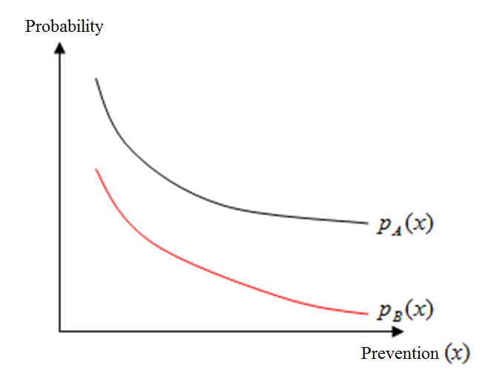
Application 1 : innovation fostering
Innovation and prevention : case of a « safety – innovation »

Slide 10
Application 1 : innovation fostering
Main findings
Considering the incentives to innovate :
Strict liability rule $≠$ negligence rule
Ranking depends on the type of innovation
Ex : . negligence = no incentives to safety innovation
. negligence > strict liability under limited liability and a cost innovation
Notes:
Intuition : negligence = exemption from liability. Cost of the damage is externalized from the firm : no incentives to innovate to reduce this cost.

Slide 11
Application 1 : innovation fostering
Further issues
Introducing the “R&D market”…
“Innovator” $≠$ “operator”
1. Is the extension from liability to the “innovator” desirable?
Fairness
Incentives

Slide 12
Application 1 : innovation fostering
A look at the model…
1 operating firm (direct author) + 1 R&D firm (indirect author)
Operating firm :
$$W_{O}−c\left(x\right)−p\left(x,e\right)θL−Y(e)$$
$θ$ = sharing rule
$$Y(e)−g\left(e\right)−p\left(x,e\right)(1−θ)L$$
R&D firm :
Social welfare :
$$W_{O}−c\left(x\right)−g\left(e\right)−p\left(x,e\right)D$$
x*, e*
Normative benchmark = maximize the social welfare,
the sum of all social benefits and costs

Slide 13
Application 1 : innovation fostering
Preliminary results :
High market power is desirable for the R&D firm.
In that case, no need to share liability with the innovator
If the innovator has few bargaining power, sharing liability is necessary to incite to sufficient R&D
Technological features have an influence on the optimal sharing rule
(The way in which prevention and innovation efficiencies combine)

Slide 14
Application 1 : innovation fostering
Further issues
2. Liability on the “innovator” : firm vs engineer ?
On the firm : which contract to design to incite engineers to do “all diligences” ?

Slide 15
Application 1 : innovation fostering
Further issues
2. Liability on the “innovator” : firm vs engineer ?
On the engineer :
Impact on the reservation wage ?
Antagonism: prevention vs innovation
Need to well define the “due diligence”
Need to define the social acceptability of the risk
Hampering innovation ?

Slide 16
Application 2
Risk regulation under “imprecise risk”,
when innovation leads to “new and imperfectly known” risks

Slide 17
Application 2 : risk regulation
A new issue : dealing with “imprecise” risks
Innovation « new and imperfectly known » risks
Ex : nanotechnologies
Imprecise risk = lack of scientific knowledge controversies
Is the new technology more or less dangerous than the « old » one?

Slide 18
Application 2 : risk regulation
So many issues to explore!!
What drives the firm’s technical choice?
How to incite to precautionary behavior?
Ex : research for more information before adoption?
Trade-off precaution vs innovation?

Slide 19
Application 2 : risk regulation
So many issues to explore!!
What drives the firm’s technical choice?
How to incite to precautionary behavior?
Ex : research for more information before adoption?
Trade-off precaution vs innovation?

Slide 20
Application 2 : risk regulation
So many issues to explore!!
Trade-off precaution vs innovation?
How to decide under uncertainty?
Uncertainty = no “clear” decision criterion
Difficulties in cost/benefit analyses
… but reversibility, flexibility are valued (options)
Uncertainty = need for public participation
To inform (potential costs.. and benefits!)
To decide, and accept
Trend : European Commission, France (nanos),…
Notes:
Criterion under uncertainty : cost-benefit… but uncertainties, especially in costs… => Reversibility, flexibility -> option value
Science and Society Action Plan, 2001

Slide 21
Application 2 : risk regulation
So many issues to explore!!
Trade-off precaution vs innovation?
What about incentives to precaution under uncertainty?
Liability = ex post and decentralized policy tool…
BUT Negligence = need of a “hard-defined” standard
Precaution : information research…
Which standard?
Firms are more informed… “average diligence”?
Collusion? Race to the bottom?
Maximal diligence? “To be in the front of the art?”
Costly… hamper innovation?

Slide 22
Application 2 : risk regulation
So many issues to explore!!
Trade-off precaution vs innovation?
Alternative decentralized policy tools?
Social responsibility?
Incentive power?
Stigmatization? (black listing)
Monitoring… who? Which cost?
Which criteria to define?
Who can define?

Slide 23
Conclusion
Economic analysis of liability :
“Mainstream economics” : rationality, optimization…
Normative benchmark : maximizing social welfare
Liability = “hard” regulatory tool (clear definitions,…)
Incentives for risk prevention, and R&D in safety systems
Innovator vs operator : sharing liability = new concern
Risk = well known rules for decision making
Uncertainty : need for new governance, new criteria
Public participation to decide, and to accept

