Slide 1
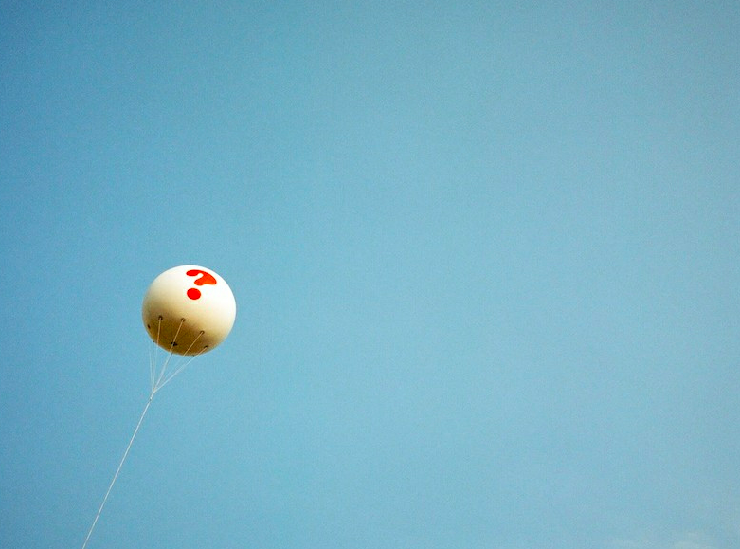



Frameworks for Responsible Innovation j.stilgoe@ucl.ac.uk
@jackstilgoe with acknowledgements to Richard Owen and Phil Macnaghten
Notes:
Me…
Responsible innovation
Richard Owen and Phil Macnaghten
Papers, book…
One example where we’ve developed this framework (EPSRC)
Repeating some of the ideas…
STORY about a balloon

Slide 2
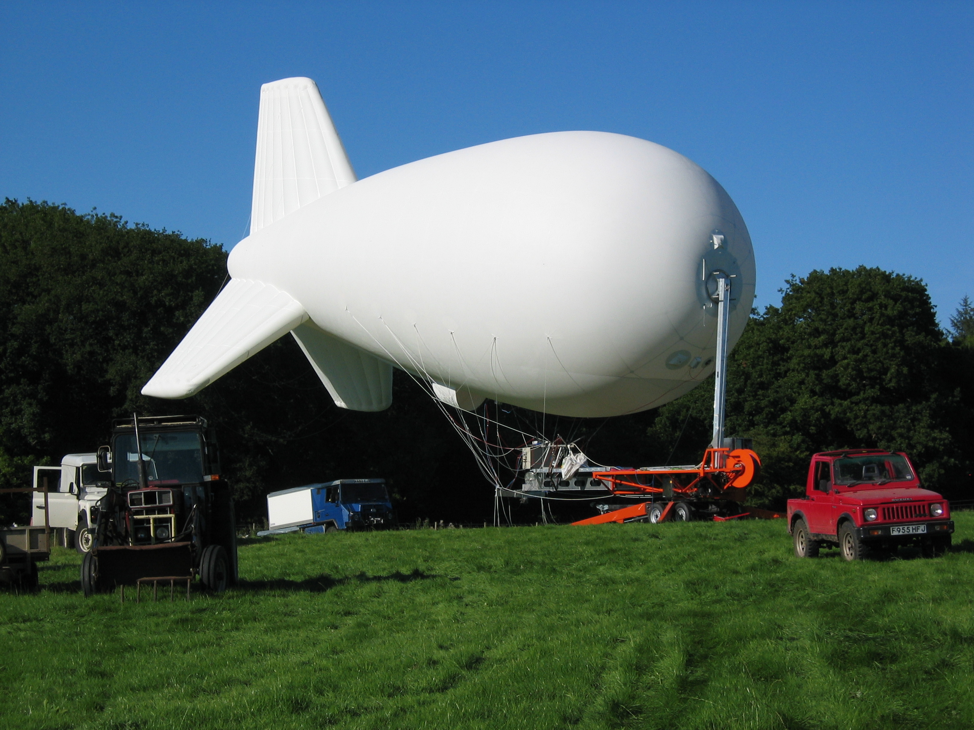
Notes:
balloon
On the ground
It wants to be in the sky

Slide 3
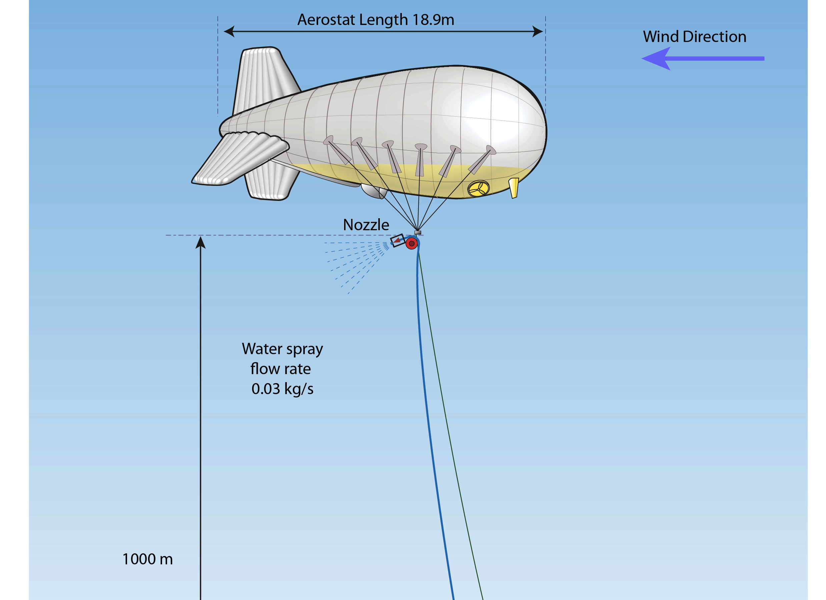
Notes:
One way of framing this experiment…
Mundane
Nothing new
No risk
No ethical concerns

Slide 4
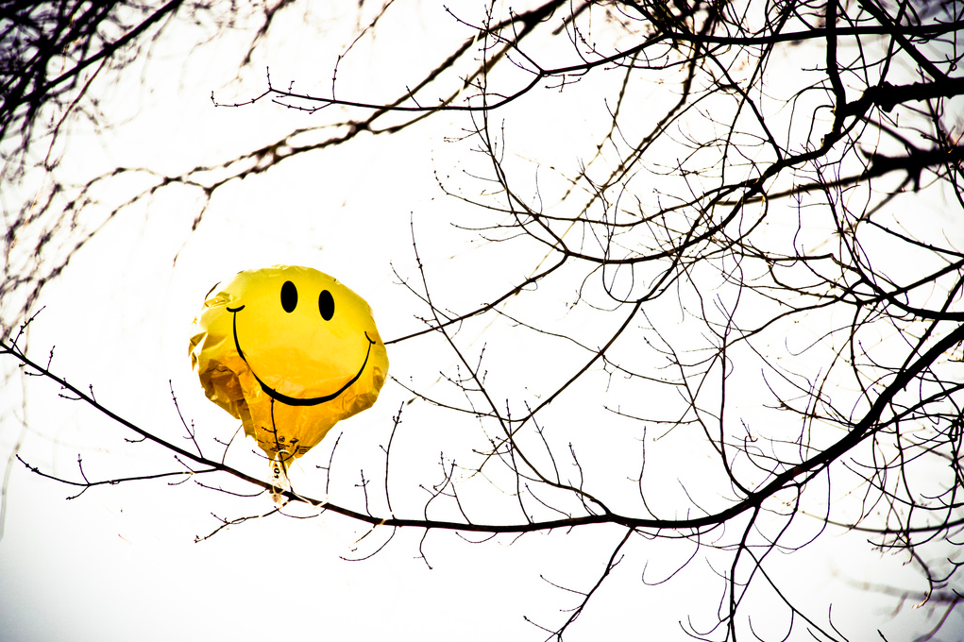
Notes:
Another way…
Controversial
Entangled (Latour, also Sheila) – unavoidably so
In a set of social and political questions
The experiment is a social one - fascinating
Governing it…
From the governance of risk to the governance of innovation

Slide 5
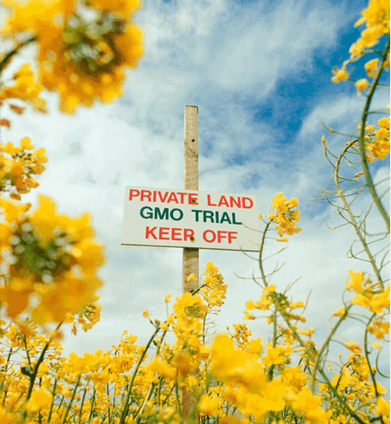
Notes:
Back to GM
Concerns about risk…
Politics… Direction of technology
Need for Early, upstream debate

Slide 6
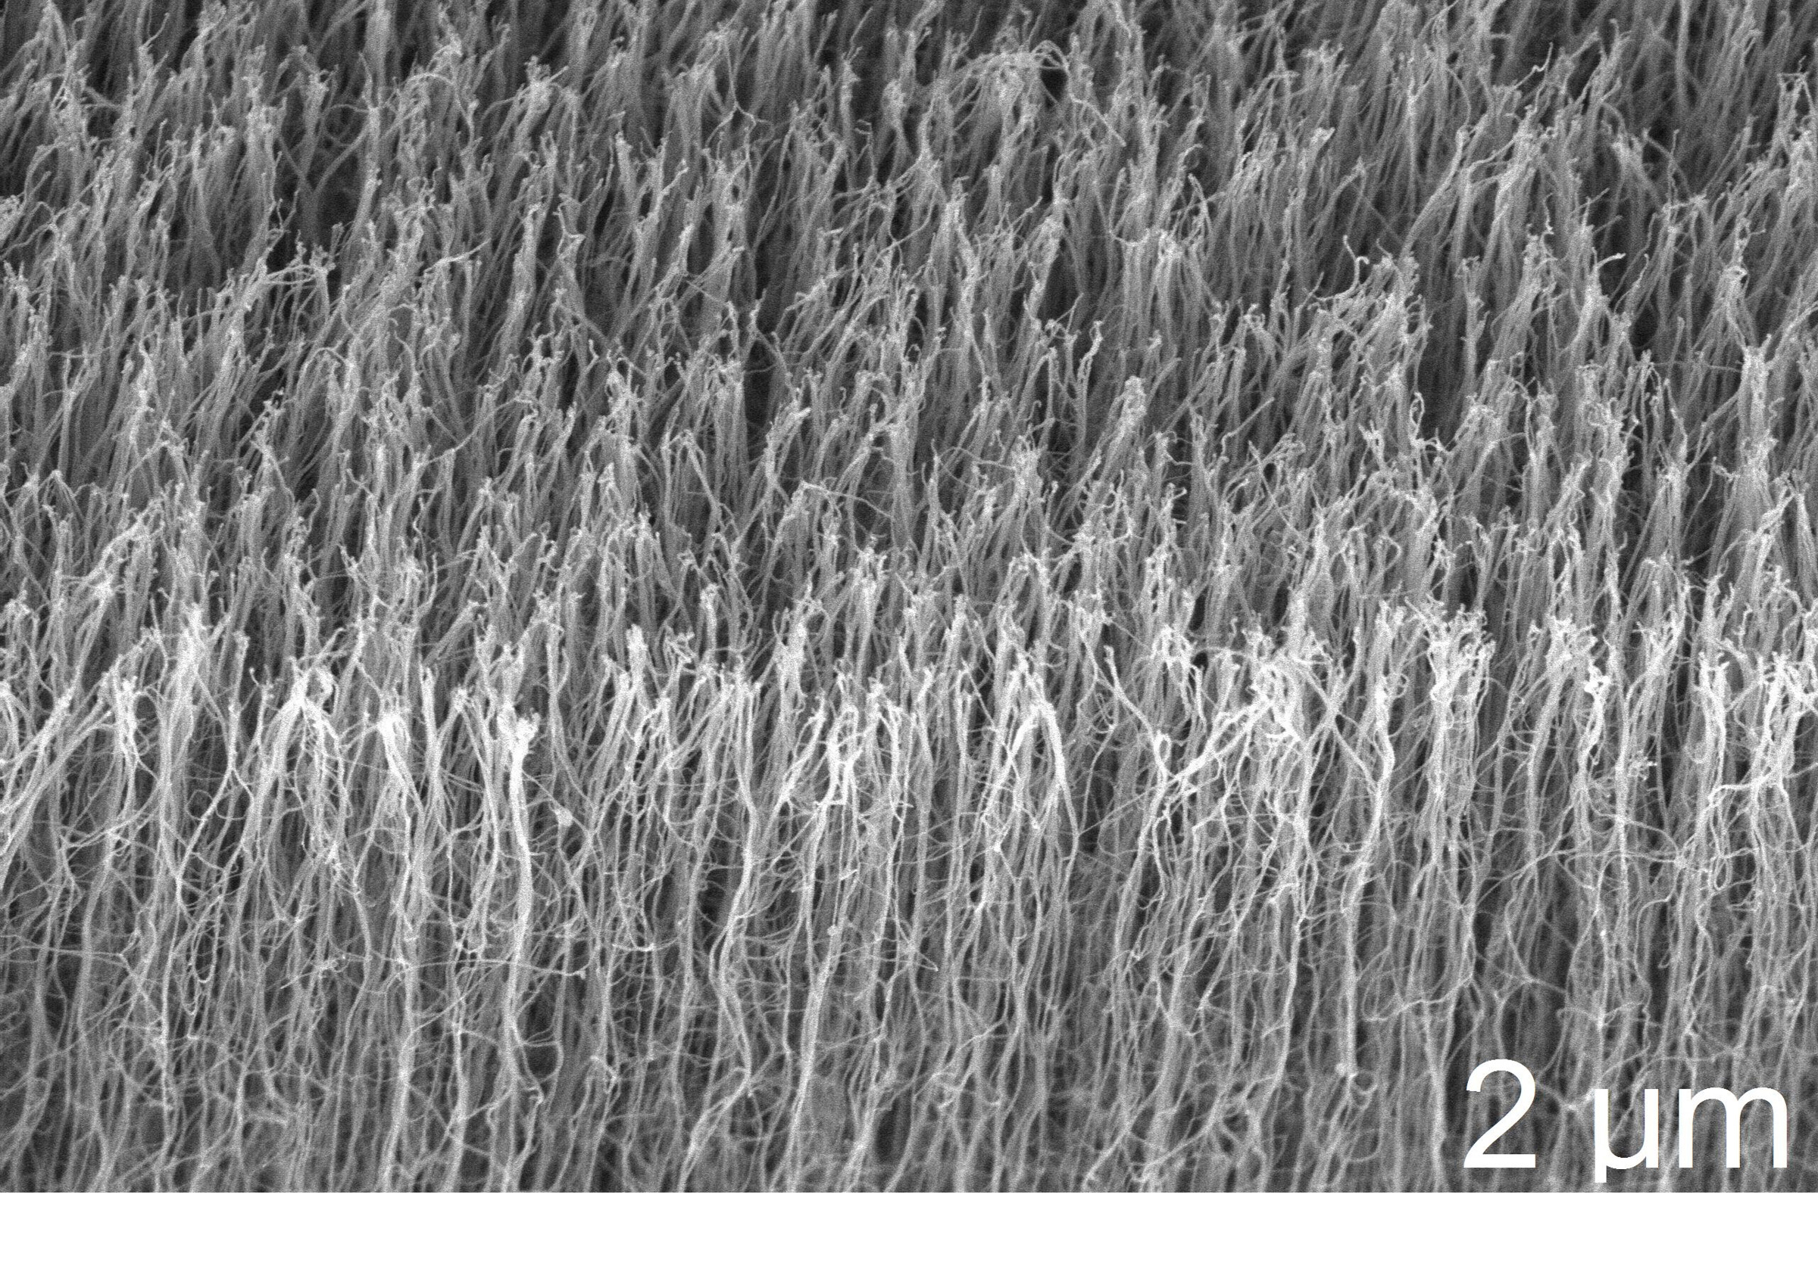
Notes:
Nanotechnology?
A field of carbon nanotubes

Slide 7
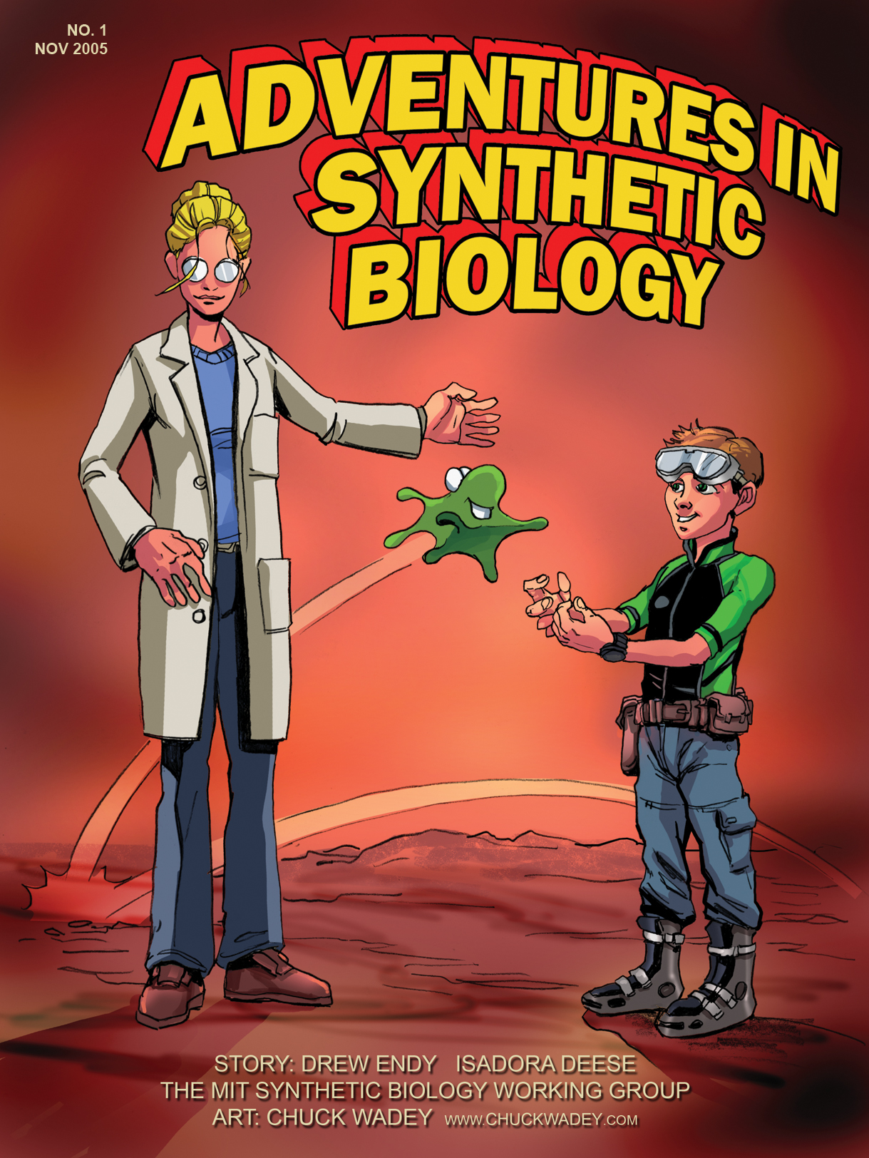
Synthetic biology
Notes:
Public dialogue

Slide 8
Notes:
From Claire Marris at King’s London

Slide 9

Notes:
Sites for experiments in governance
Public dialogue
Want answers
Get questions

Slide 10

What is the purpose?
Why do you want to do it?
What are you going to gain from it?
What else is it going to do?
How do you know you are right?

Slide 11
‘Research Councils have a responsibility to scrutinize the potential impacts and risks of emerging technologies, and encourage the researchers we fund to do likewise.... The challenge will be to define an approach that promotes creativity and innovation in research underpinned by a commitment to its responsible development.’
David Delpy, ESPRC CEO
Notes:
This what I’ve been working on
Advising EPSRC
Working on a particular case

Slide 12
The what, the how and the why of innovation
Products What are the likely risks and benefits ? How will the risks and benefits be distributed? What other impacts can we predict ? How might these change in the future? What don’t we know about? What might we never know about? | Processes How should research and innovation take place? How should standards be drawn up and applied? How should risks and benefits be defined and measured? Who is in control? Who will take responsibility if things go wrong? What if we are wrong? | Purposes Why should this research be undertaken? Who will benefit ? What are the alternatives? Who gets to decide?
Notes:
Sites for experiments in governance
Public dialogue
Want answers
Get questions
Governance of products of innovation – purposes – purposes

Slide 13
Pathologies of innovation
  Late lessons from early warnings (EEA)
  The dilemma of control (David Collingridge)
  Systemic risk and normal accidents (Charles Perrow)
  Technological lock-in (Paul David)
  Myths of techno-fixes (Dan Sarewitz)
  Altered nature of human action (Hans Jonas)
  Organised irresponsibility (Ulrich Beck)
  Expectations and Imaginaries (Brown, Hedgecoe, Jasanoff, Wynne et al.)
  Deficit models of publics (Brian Wynne)
  Society as a laboratory (Krohn and Weyer)
Notes:
Addressing some pathologies that have been indentified from various perspectives – philosophy, STS, economic history
Organised irresponsibility – Autonomy, serendipity, Lets scientists off the hook.

Slide 14
On responsibility
From retrospective… (accountability and liability)
… to prospective (care and responsiveness)
… and collective
Role responsibilities and general responsibilities
Second-order (or meta-)responsibilities
Notes:
Framework
Following the work of people like Hans Jonas, Luigi Pellizoni

Slide 15
On innovation
Non-linear
Socio-technical
Systemic
Responsible innovation is ‘collective care for the future through the stewardship of innovation in the present’
Notes:
Non-linear
Nanocode…

Slide 16
Four characteristics of responsible innovation
Reflexive
Anticipatory
Responsive
Inclusive
Notes:
Four dimensions
Three are familiar
Reflexive – thinking about commitments and assumptions
Anticipatory – not predictive
Inclusive –
Responsive – two meanings - to answer and to react

Slide 17
Making innovation responsible
Governance experiments
Life-cycle analysis
Risk assessment
Ethics committees
Public dialogue
Foresight
Codes of conduct
CTA/RTTA/midstream modulation/STIR etc.
… and more
De facto governance
Multidisciplinary collaboration
Technology appraisal
Training and capacity-building
Institutional structures
Reward and recognition
Intellectual property
Standards
Publication
Peer review
Political economy of science
… and more
Notes:
Asking and answering these questions - Making innovation responsive…
De facto governance – Pellizoni – a logic of unresponsiveness

Slide 18
Notes:
Depends what Klaus said
Rationale for European framework
Europe is a substantial governance actor in itself
Important role in shaping trajectories through funding
Grand challenges
Harmonising – unsure?
Best practice – although we don’t know what counts as ‘best’ – “interesting practice”?

Slide 19
Rationales for a European framework/frameworks
Sharing ‘best practice’
Harmonising regulation
A new narrative for science in society
A new narrative for “Science in Society”
Europe as powerful governance actor
  Grand challenges
  Horizon 2020
Anchoring innovation to European values
Moving from application to iteration
Notes:
Europe is a substantial governance actor in itself
Important role in shaping trajectories through funding
Grand challenges
Harmonising – unsure?
Best practice – although we don’t know what counts as ‘best’ – “interesting practice”?
European values
Is RRI about means or ends?

Slide 20
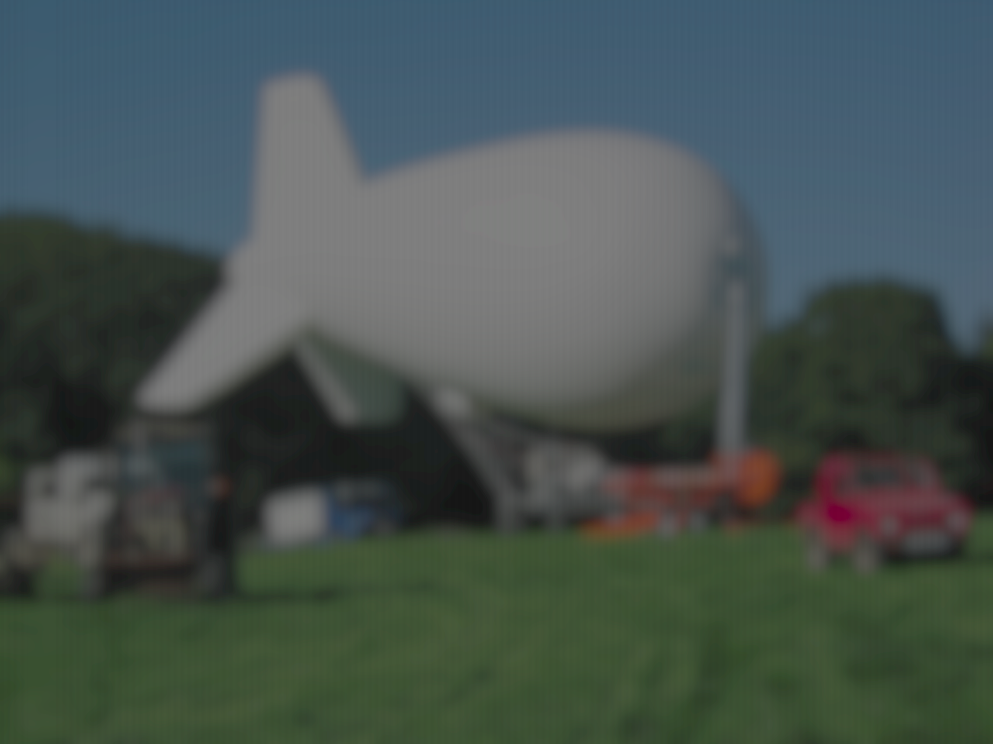
“The imaginary made real”
Notes:
This is why
The vision
Governance process
Stage gate – sailed through university ethics committees. Everyone agrees it is benign
Intent matters

Slide 21
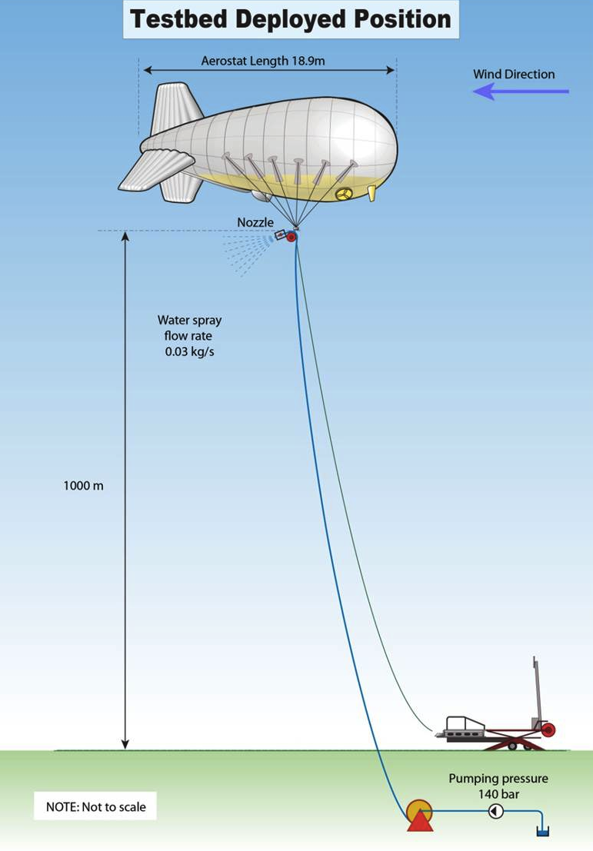
Stratospheric Particle Injection for Climate Engineering (SPICE)

Slide 22
Notes:
This is why
The vision
Governance process
Stage gate – sailed through university ethics committees. Everyone agrees it is benign
Intent matters

Slide 23
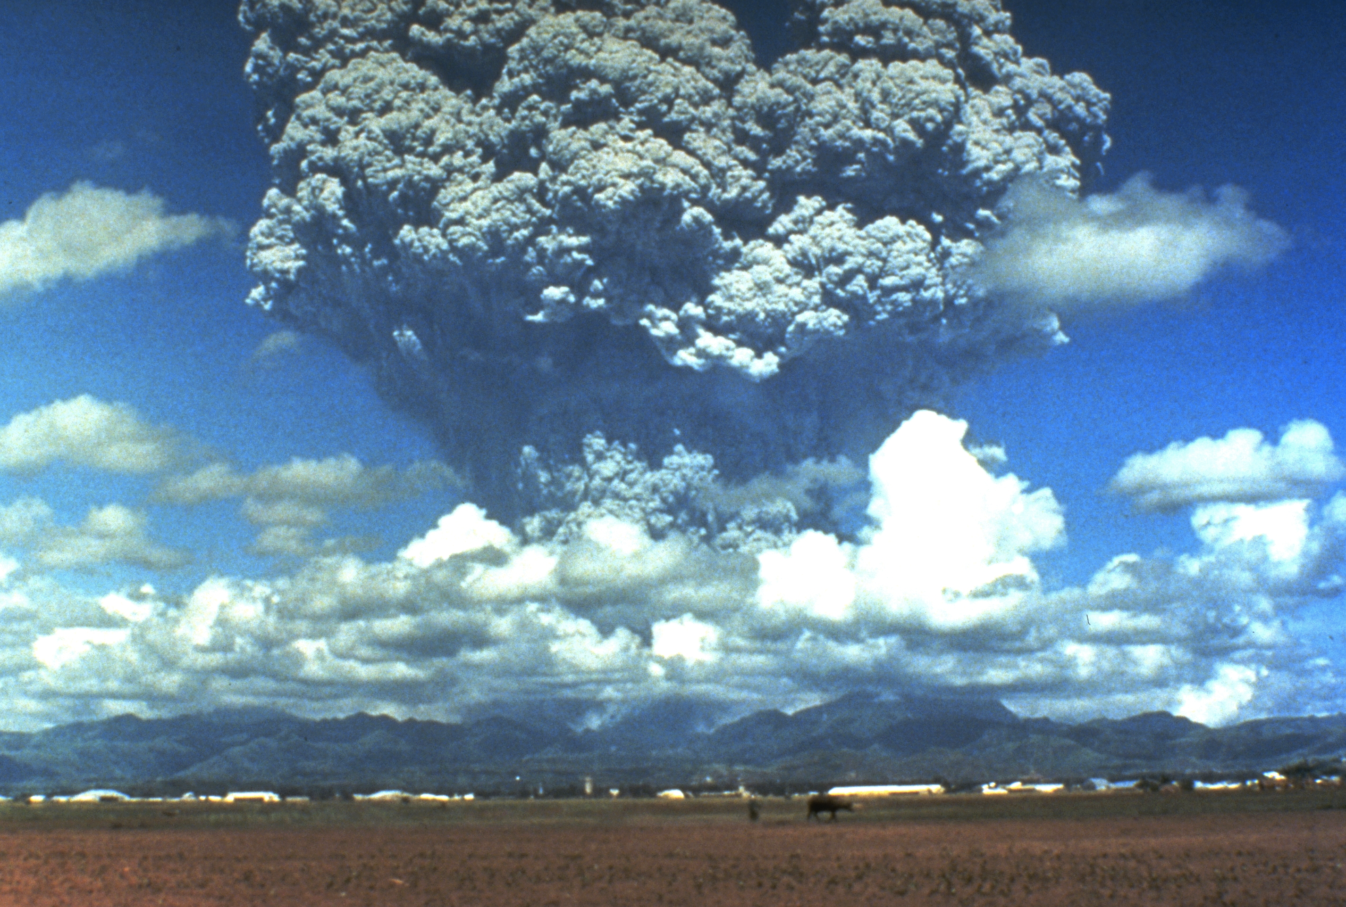

Slide 25
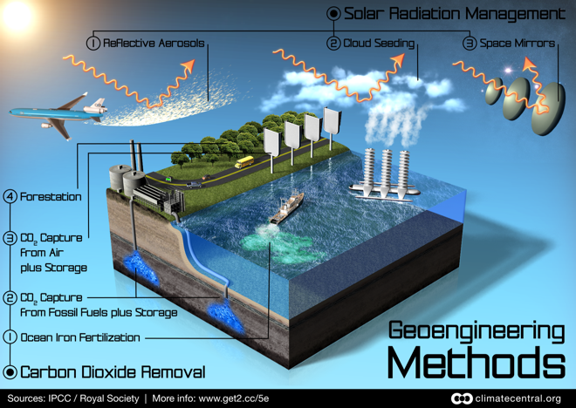

Slide 26


Slide 27
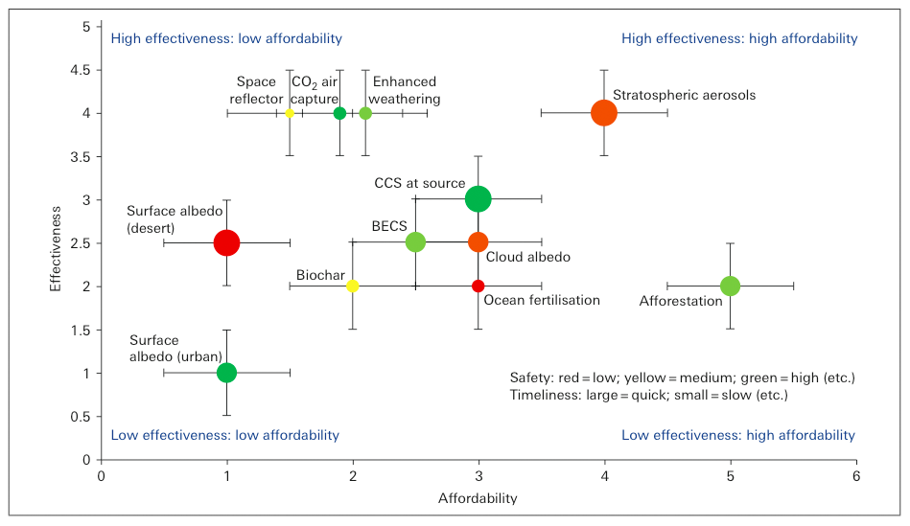

Slide 28
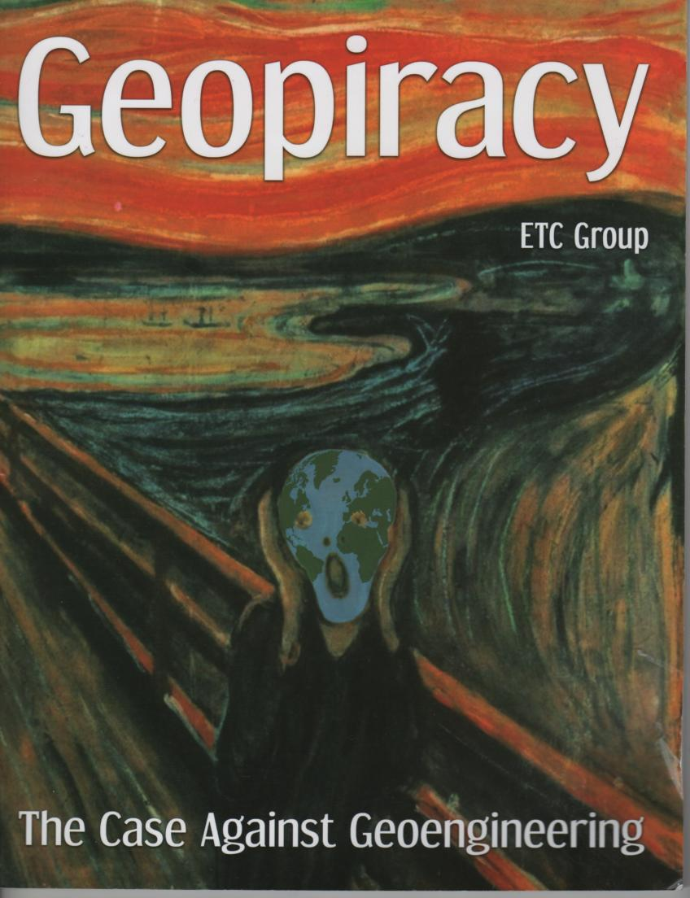
Notes:
ETC group single most important TA organisation in the world

Slide 29
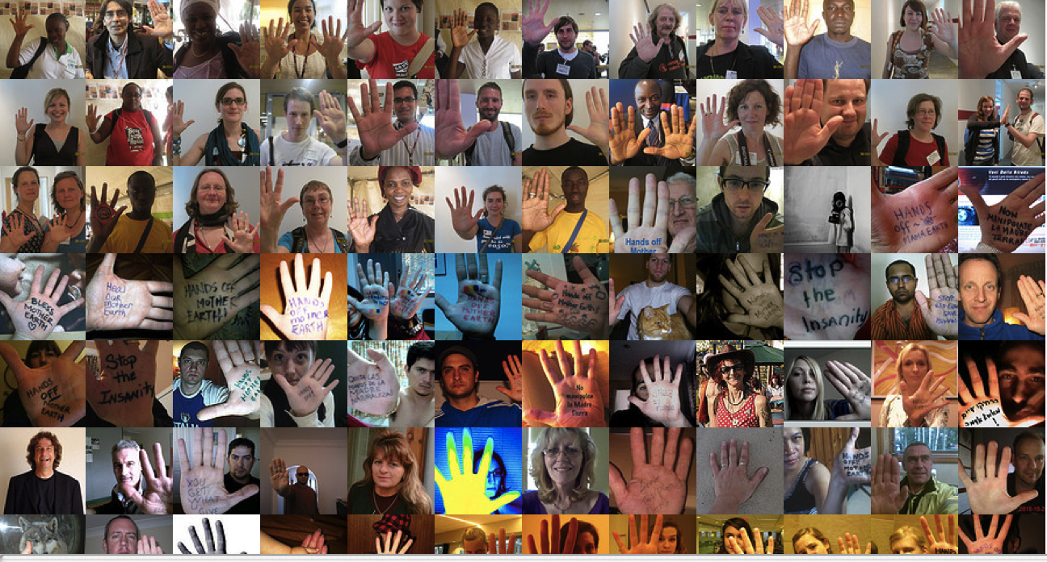


Slide 30



Slide 31
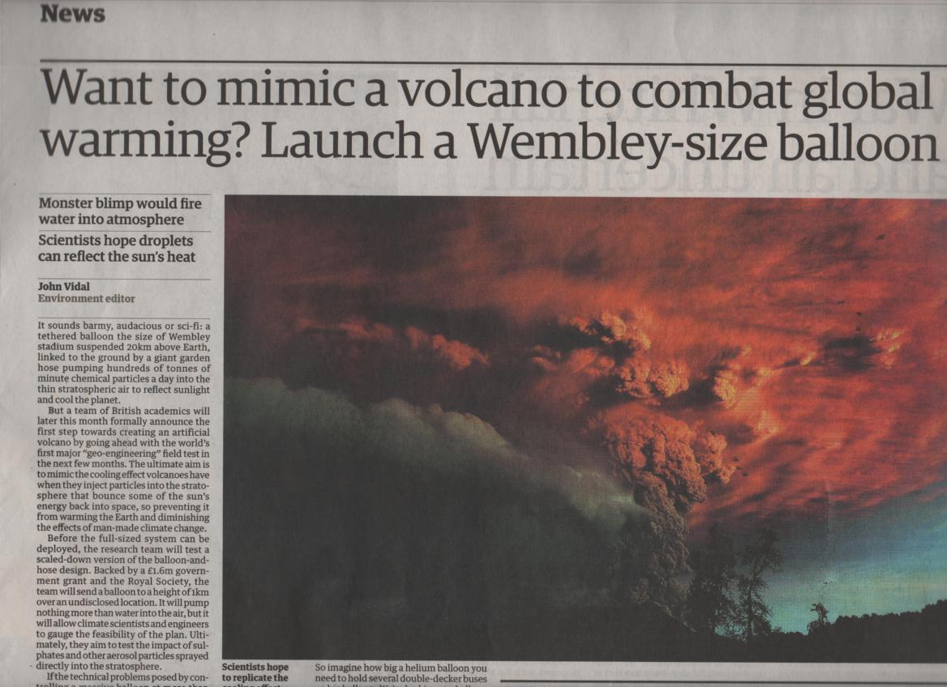

Slide 32
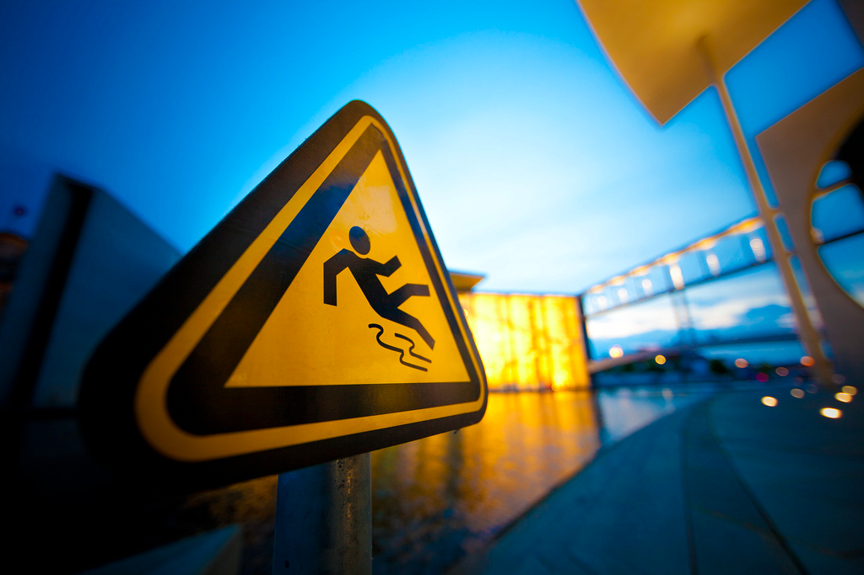
A Stage gate

Slide 33
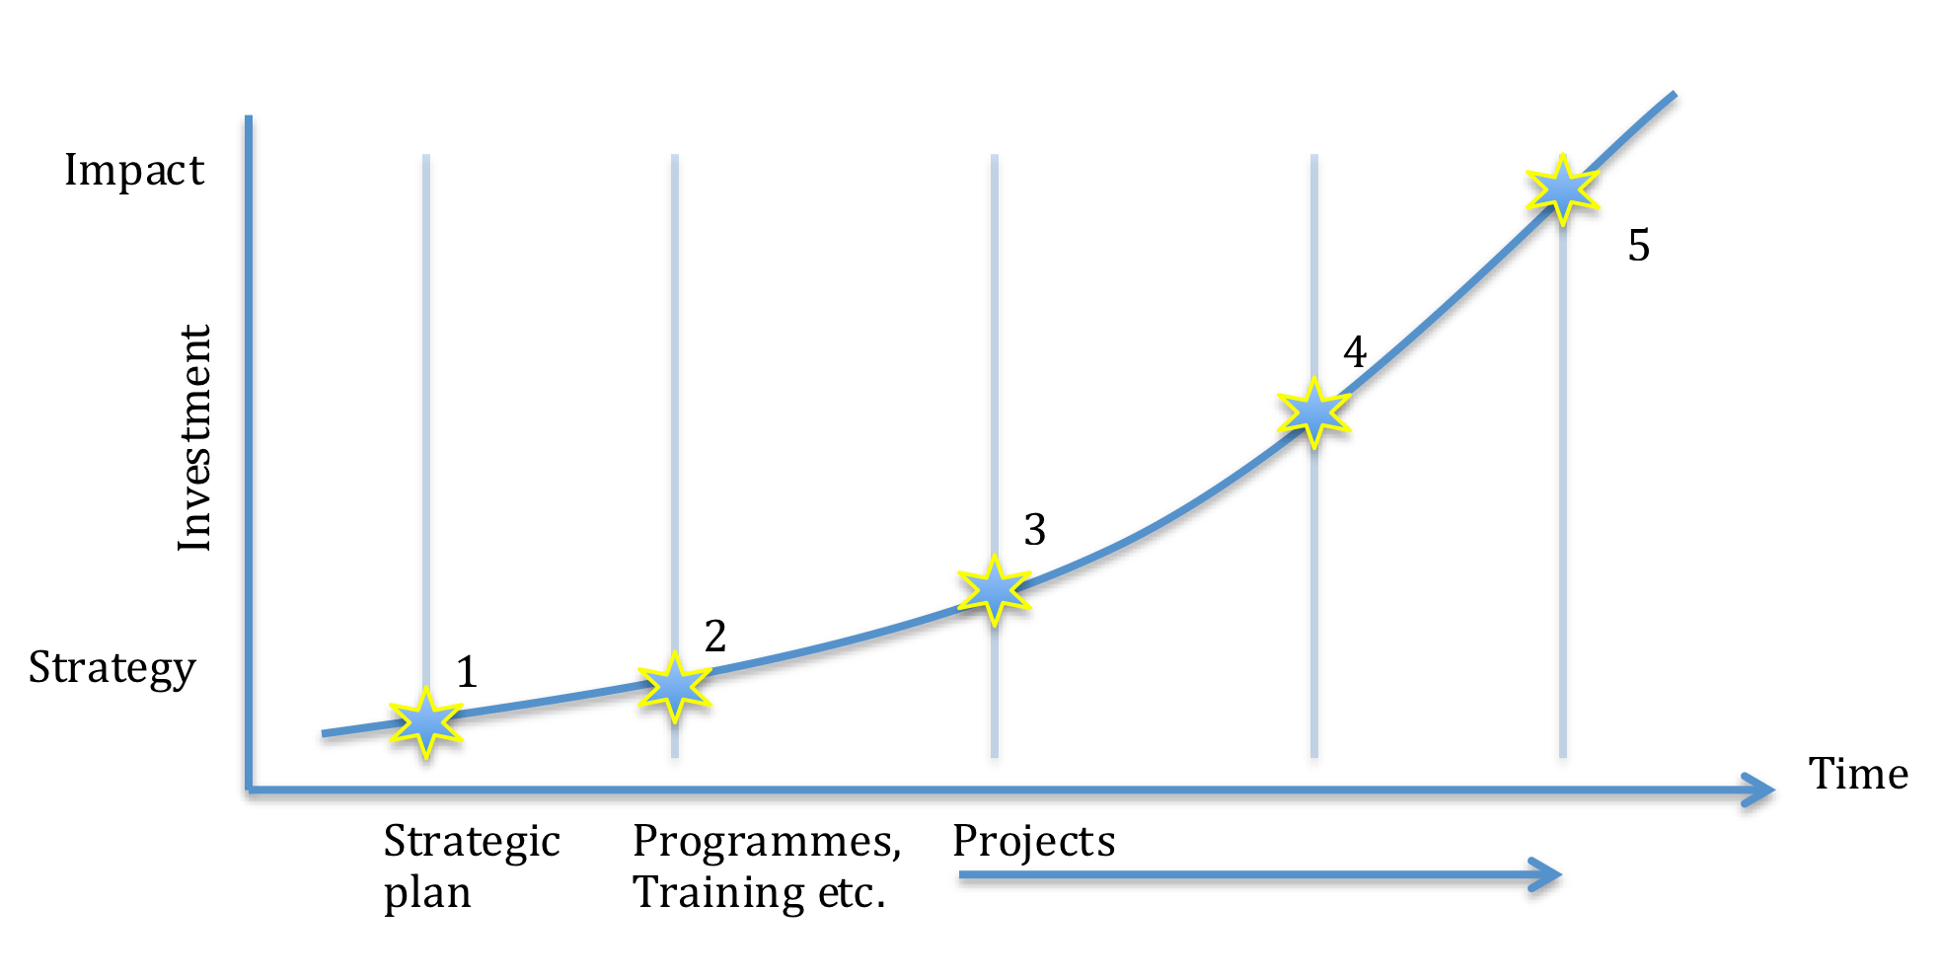
A Stage gate

Slide 34
Stage gate criteria
Safety
Compliance
Framing and Communication (reflexive)
Imagination of applications and implications (anticipatory, reflexive)
Hearing public and stakeholder views (inclusive)

Slide 35
Notes:
Taken by surprise
A patent

Slide 36
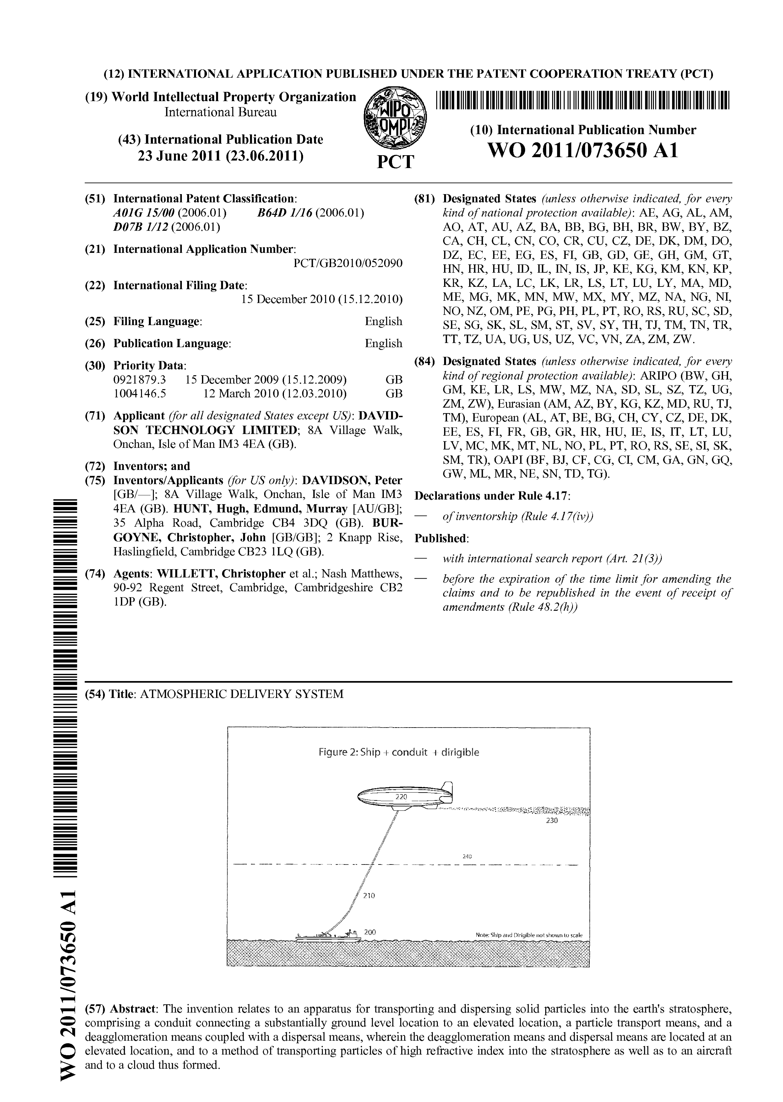
Notes:
A rather unequivocal statement of intent
Possible conflict of interest
RESPONSIVENESS

Slide 37
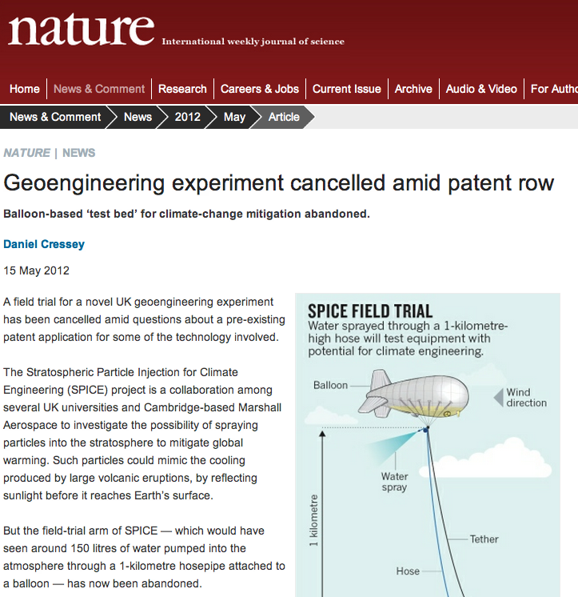
Notes:
Except that…
May have heard that last week
Cancelled

Slide 38
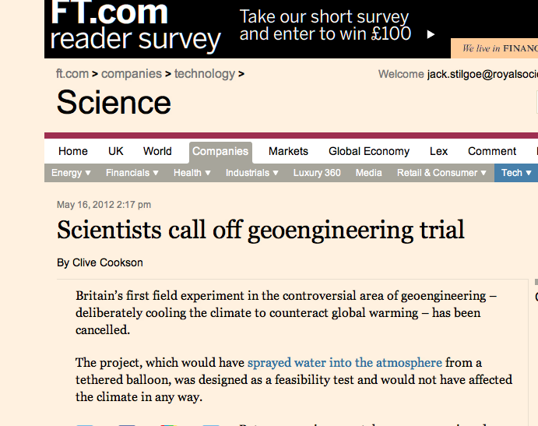

Slide 39
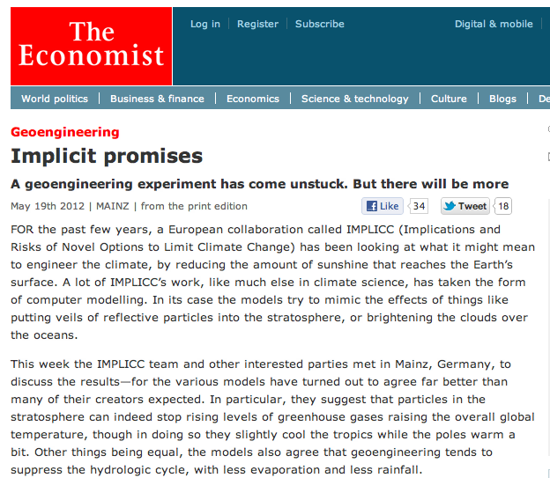

Slide 40
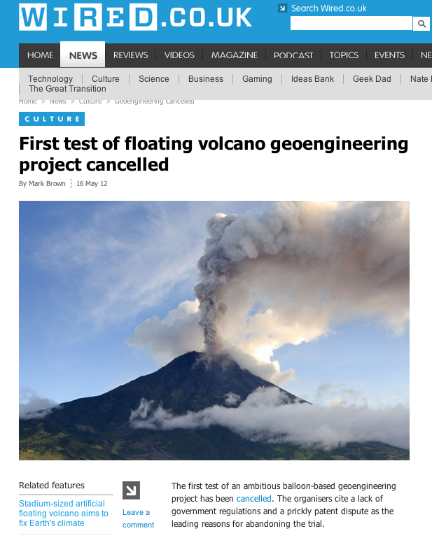

Slide 41
Notes:
Not just patents…

Slide 42
